Slide 1
Weekly Discovery Report 3
CycleSIGHT
Aiyana, Gloria, Farruh
Because pain isn’t one-size-fits-all.

Slide 2
CycleSIGHT
What is CycleSIGHT?
The Problem
Millions of deaths annually are linked to liver and kidney disease, risks exacerbated by the repeated use of common NSAIDs. For women managing chronic menstrual pain or undiagnosed endometriosis, this reliance is often a "trial-and-error" necessity. However, without genetic screening, these patients remain unaware of variants that impair drug metabolism and increase their susceptibility to organ damage, turning routine pain management into a silent health crisis
How we want to solve this problem?
CycleSIGHT offers a laboratory-developed test (genetic and symptom-based) that helps clinicians personalize menstrual pain treatment and identify hidden risks. The test looks for variants related to NSAID drug metabolism (SNPs rs1799853 and rs1057910 in the CYP2C9 gene on chromosome 10 ), pain sensitivity (SNPs rs4680 in the COMT gene on chromosome 22 and rs20417 in the PTGS2 (COX-2) gene on chromosome 1), and endometriosis risk (SNPs rs17561 in IL1A gene on chromosome 2 and rs7521902 in the WNT4 gene on chromosome 1).

Slide 3
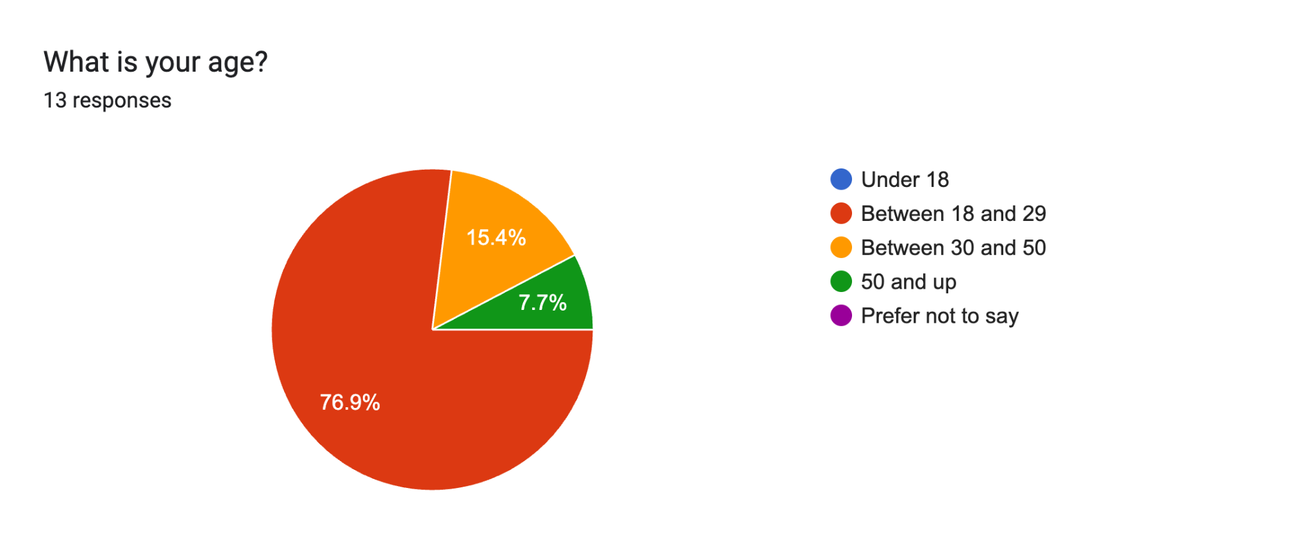
Q1.

Slide 4
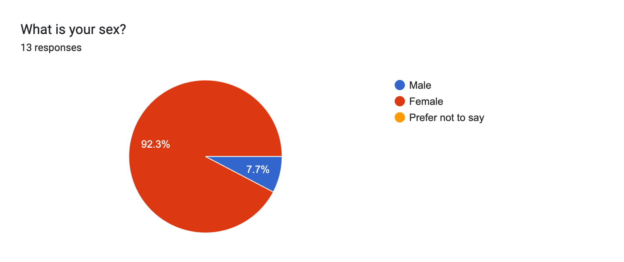
Q2.

Slide 5
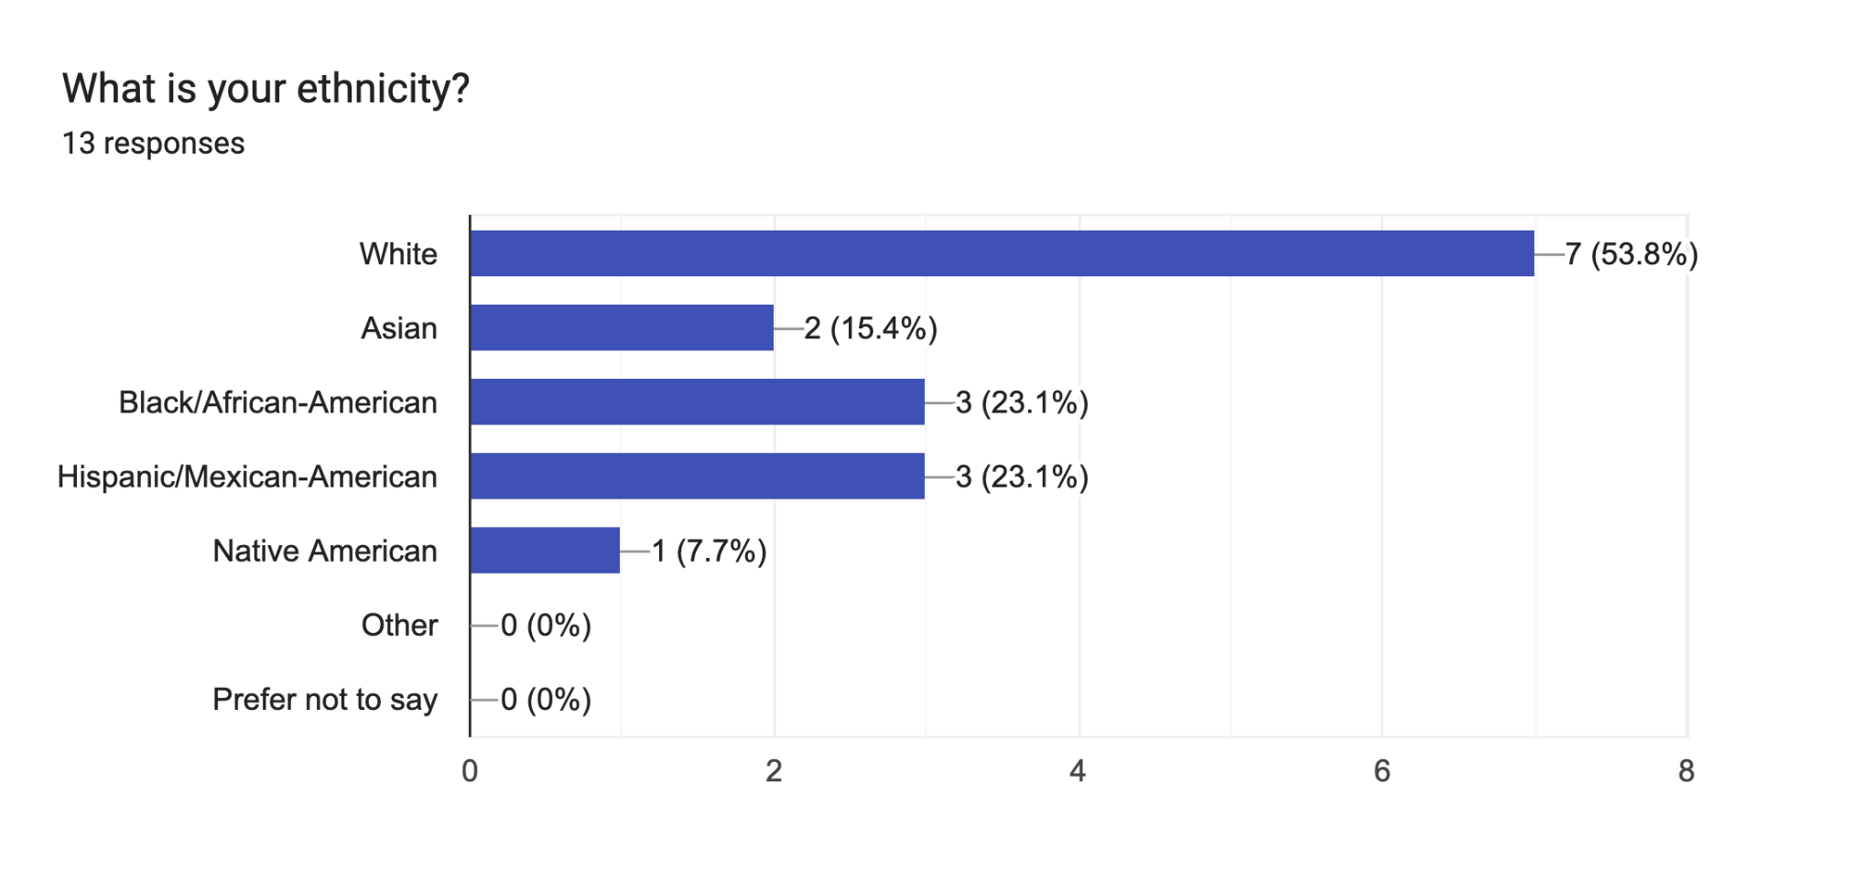
Q3.

Slide 6
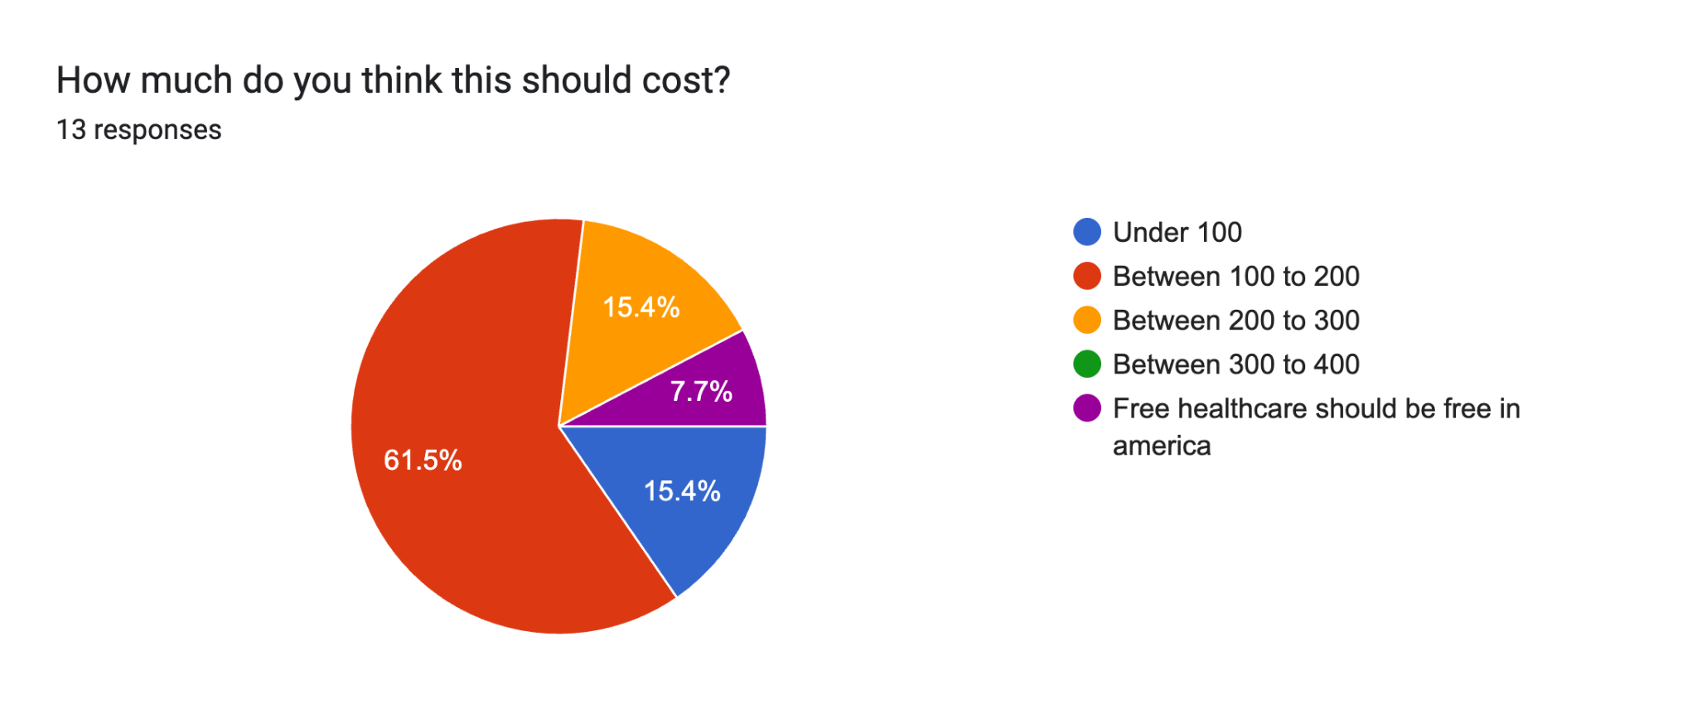
Q4.

Slide 7
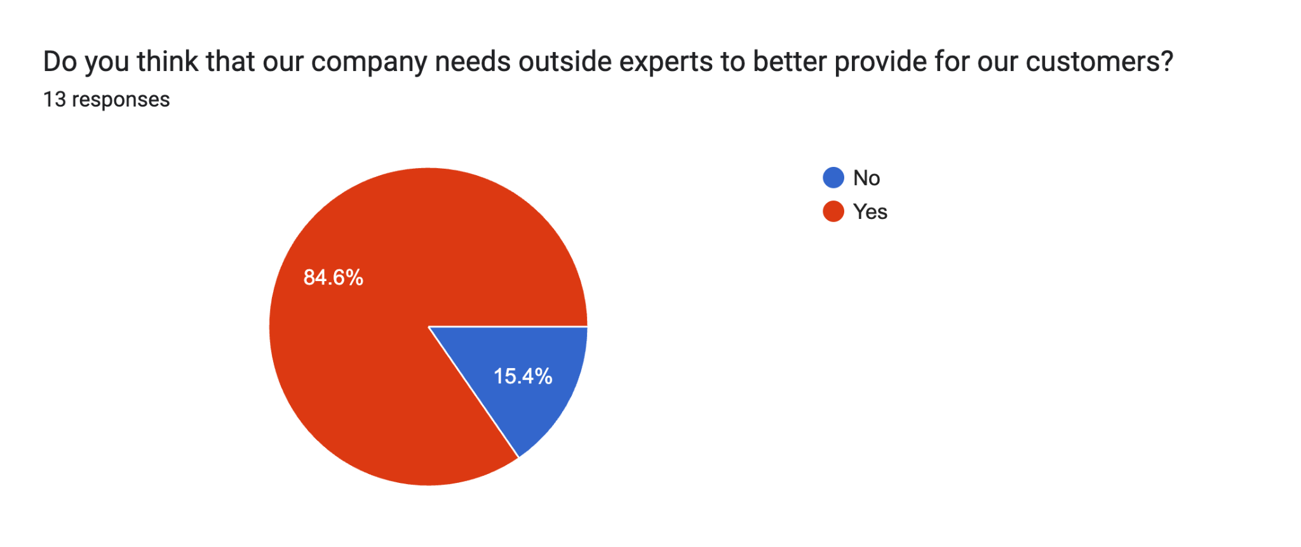
Q5.

Slide 8
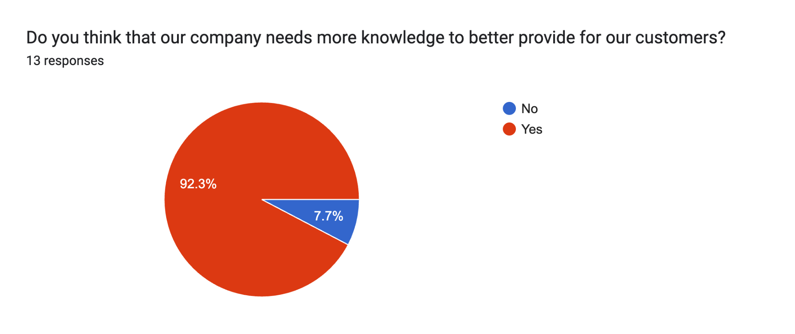
Q6.

Slide 9
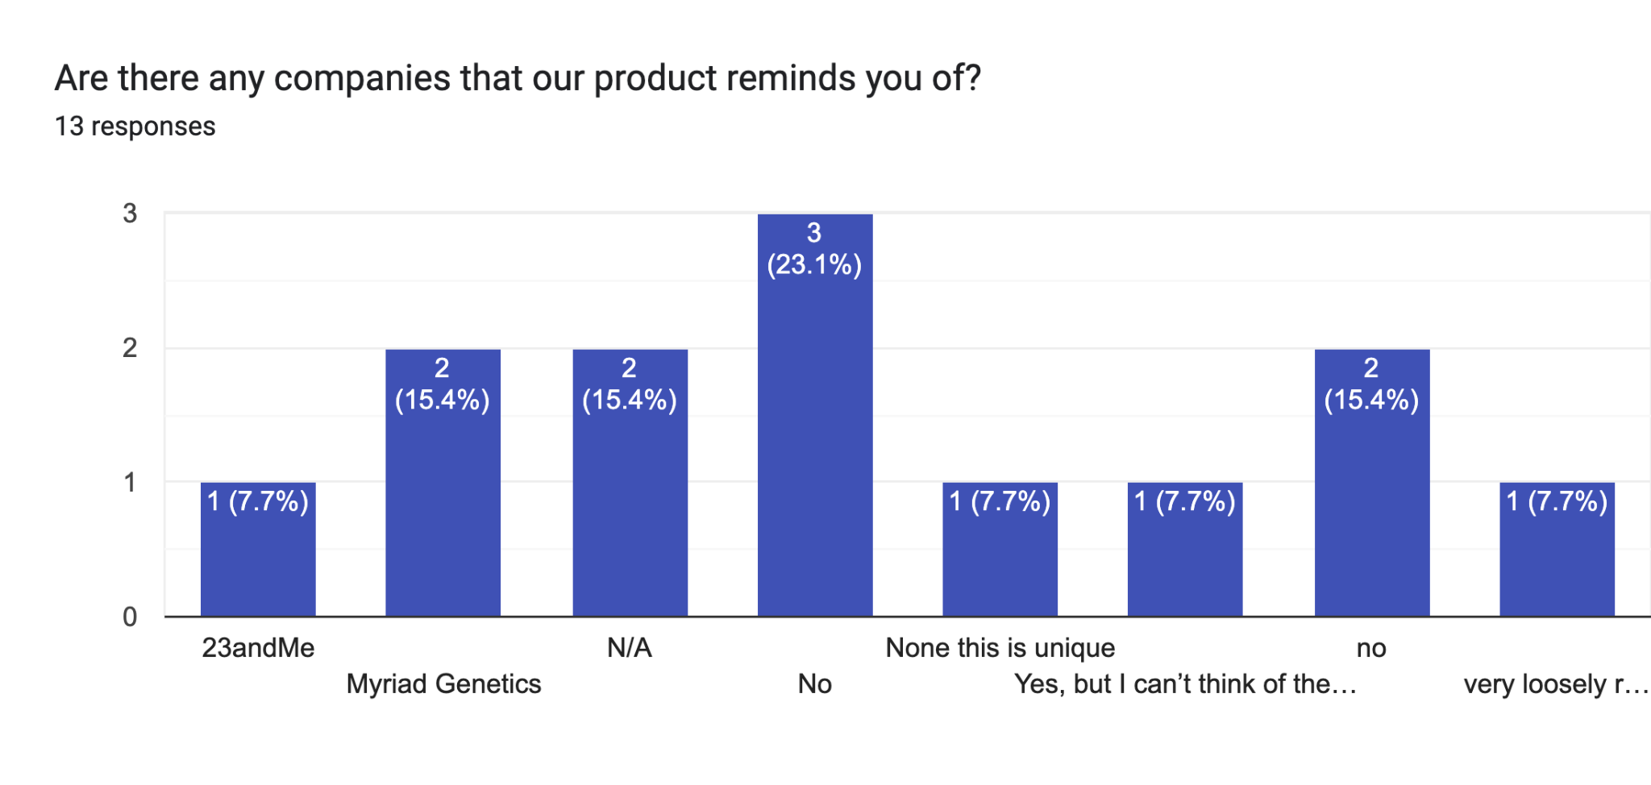
Q7.

Slide 10
Thank you.

